Slide 1
ECO101: Introduction to Microeconomics
Lecture 2

Slide 2
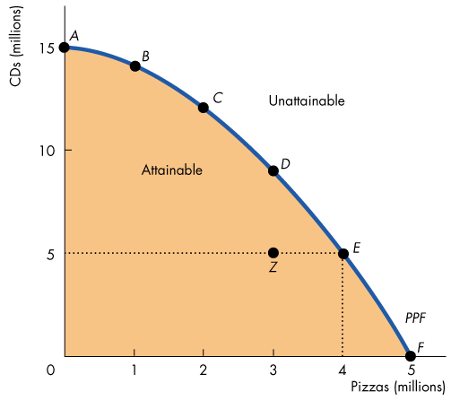
Production Possibility Frontier (PPF)
The production possibilities frontier (PPF) is the boundary between those combinations of goods and services that can be produced and those that cannot.
Notes:
1. The production possibilities frontier for CDs and pizza
shows the limits to the production of these two goods,
given the total resources available to produce them.The PPF illustrates scarcity because we cannot attain
the points outside the frontier. They are points that
describe wants that can’t be satisfied. We can produce at
all the points inside the PPF and on the PPF. They are
attainable points.

Slide 3
Production Possibility Frontier (PPF)
Production Efficiency: We achieve production efficiency if we cannot produce more of one good without producing less of some other good
PPF involves trade-off Opportunity Cost
Notes:
If we produce at a point inside the PPF such as Z, we
can use our resources more efficiently to produce more
pizzas, more CDs, or more of both pizzas and CDs. But
if we produce at a point on the PPF, we are using our
resources efficiently
Every choice along the PPF involves a trade-off – we
must give up something to get something else.
The opportunity cost of an action is the highest-valued
alternative forgone.

Slide 4
Production Possibility Frontier (PPF)
Increasing Opportunity Cost
Why does the PPF bows outward ?
Notes:
Increasing Opportunity Cost
The opportunity cost of a pizza increases as the quantity of pizzas produced increases. Also, the opportunity cost of a CD increases as the quantity of CDs produced increases
Why PPF bows outward- The PPF is bowed outward because resources are not all equally productive in all activities. Imagine People with several
years of experience working for Philips are good at producing CDs but not very good at making pizzas. So if we move some of these people from Philips to Domino’s, we get a small increase in the quantity of pizzas but a large decrease in the quantity of CDs.

Slide 5
PPF and Marginal Cost
The PPF determines opportunity cost.
The marginal cost of a good or service is the opportunity cost of producing one more unit of it.
Increasing opportunity cost of a pizza means increasing marginal cost of a pizza
Notes:
Marginal cost is calculated from the slope of the PPF. As the quantity of pizzas produced increases, the slope of PPF gets steeper and hence the marginal cost of a pizza increases.

Slide 6
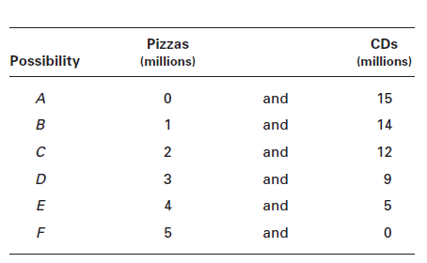
Calculating Marginal Cost
Let us draw a PPF out of this:
Notes:
Students always wonder why MC passes through the middle point of the bars.
The height of each bar shows the cost of an average pizza in each of the 1 million pizza blocks. Focus on the 3rd 1 million pizzas. The opportunity cost of producing that 1 million pizzas is 3 million CDs. So in this range, the cost of an average pizza is 3 CDs.
The dot indicates that 3CDs is the cost of the average pizza, which over this range is the 2.5 millionth pizza.
Because this relationship between the marginal value of a continuous variable and a discrete variable arises many time in economics, it is worth spending a few minutes of it here.
.

Slide 7
Preferences and Marginal Benefit —
Marginal benefit- benefit received from consuming one more unit of goods and service —this depends on people’s likes and dislikes and it is totally unrelated to PPF

Slide 8
Allocative Efficiency —
Allocative efficiency- When we cannot produce more of any one good without giving up some other good that we value more highly, we have achieved allocative efficiency. Such that it’s an optimal distribution of goods and it is determined by the point where MC=MB

Slide 9
Economic Growth
The expansion of production possibilities − and increase in the standard of living − is called economic growth.
Two major factors of economic growth:
1. Technological change - is the development of new goods and of better ways of producing goods and services.
2. Capital accumulation - is the growth of capital resources, which includes human capital.

Slide 10
The Cost of Economic Growth
Economic growth is not free
• To use resource in research and development, we must decrease our production of consumption goods and services
Hence opportunity cost of Economic growth is less consumption today

Slide 11
Gains From Trade
Comparative advantage- A person has a comparative advantage in an activity if that person can perform the activity at a lower opportunity cost than anyone else.
Absolute advantage- A person has an absolute advantage if that person more productive than others.

Slide 12
Essential Reading for Today!
Parkin, Powell, Matthews. Economics. 8th Edition
Chapter 2: Pages 32 to 42

